Slide 1
Group project by Simon Ngo, Kola, Mason

Slide 2
Proposal 1
game/visualise encryption
numeric peg system

Slide 3
numeric peg system
Concept 1:
game/visualise encryption
numeric peg system
Purpose:
Teach the concept of Numeric peg system
Theme:
memory improver

Slide 4
numeric peg system
Linking a numbers 0-9 to a pictures/symbols to assist in numbers memorisation
each number 0-9 as to connect to a image visually, something you can picture/associate in your mind.
e.g. 0=ball, 1=pen, 2=swan, 3=McDonald, 4=chair, 5=hook, 6=cherry, 7=thunder, 8= race track, 9= balloon

Slide 5

Numeric peg system
1 =
Notes:
Lynda Numeric peg system example list

Slide 6

Numeric peg system
2 =

Slide 7

Numeric peg system
3 =

Slide 8
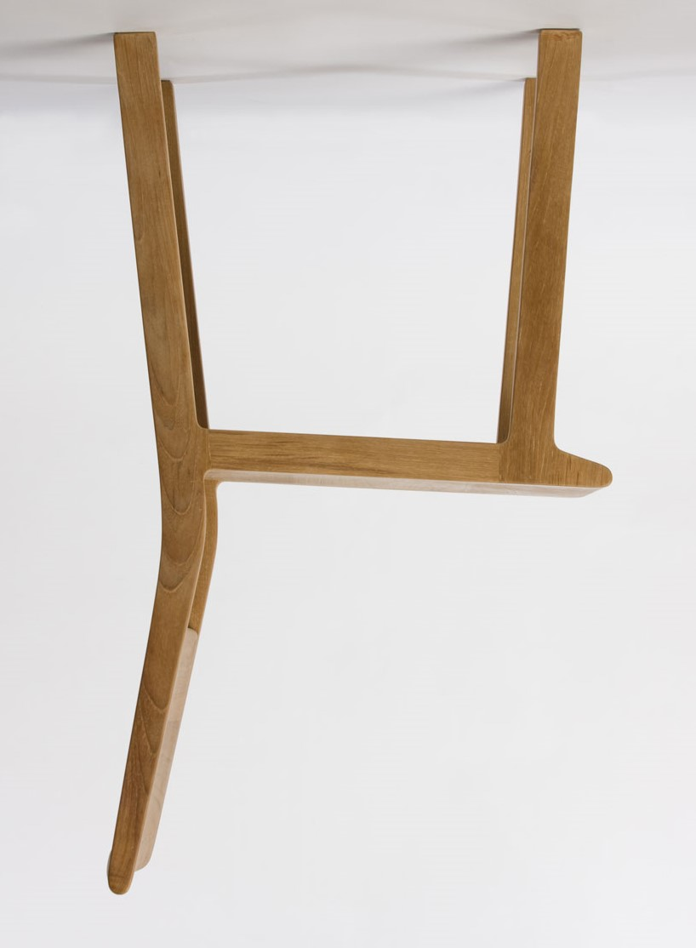
Numeric peg system
4 =

Slide 9

Numeric peg system
5 =

Slide 10

Numeric peg system
6 =

Slide 11


Numeric peg system
7 =

Slide 12

Numeric peg system
8 =

Slide 13


Numeric peg system
9 =

Slide 14







Numeric peg system
1 =
2 =
3 =
4 =
5 =
6 =
7 =
8 =
9 =

Slide 15
background research
Concept 1
Purpose/concept direction:
Numeric peg system
aid short term memory
improve memory to memorise numbers
Learning through game

Slide 16
Inspiration &Influence:
lynda.com course on Improving Your Memory by Paul Nowak
caesarCipher
Memory techniques
GCHQ-Government Communications Headquarters
“”picture worth a 1000 words””
Lynda.com course Gamification-Learning through game

Slide 17
Game suggestion ideas
Level 1- Cipher Images
1.game that teach the basic concept of numeric peg system
2.Draw shape number
3. encryption math game
4.cipher number from a picture
5. Number Catchphrase
= __? Please type number

Slide 18

Game suggestion ideas
Level 2- pairs game
1.game that teach the basic concept of numeric peg system
Answer:
1
3
2
1
2
3

Slide 19
technical specification
Concept 1
Program use
Python to process the data
processing-data visualisation
Website
html
CSS
Bootstrap
adobe Photoshop, illustrator to make the object/picture

Slide 20
Proposal 2
visualise cv/job skills comparison site

Slide 21
visualise cv/job skills comparison
Concept 2:
visualise cv/job skills comparison site
Purpose/Concept Direction:
cv/job skills comparison site
allow user to convert a normal cv into a visualise cv
strength & weakness builder
compare your skillsets with the jobs visually
allow user to see what see skillset to improve on
advice how to develop these skills

Slide 22
background research
Concept 2
Average time spent looking at a CV is 5-7 seconds. source (telegraph 2015)
most employers spend less than 30 seconds reading a CV. source (telegraph 2015)
“”picture worth a 1000 words””

Slide 23
CV/job career comparison
Example:
CV
Personal Profile:
A computer graduate
Key Skills:
HTML5
CSS
Education:
Raven Bourne College
Experience:
1 yr web developer
Example:
Font End Developer
Essential skills
HTML
CSS
JavaScript
CMS
wordpress,drupal
Skillsets:
Communication
Team player
Agile development etc.
Desirable:
Adobe creative suite

Slide 24
Inspiration &Influence:
Interactive Shakespeare
http://vizualize.me/
https://enhancv.com/
http://ineedaresu.me/
Personal experience- comparing cv to job advert skill sets long process.
GCHQ-Government Communications Headquarters

Slide 25
technical specification
Program use:
Python to extract and process the data
Processing to create the visual side
Html
CSS
bootstrap
Backend- Flask server side

Slide 26
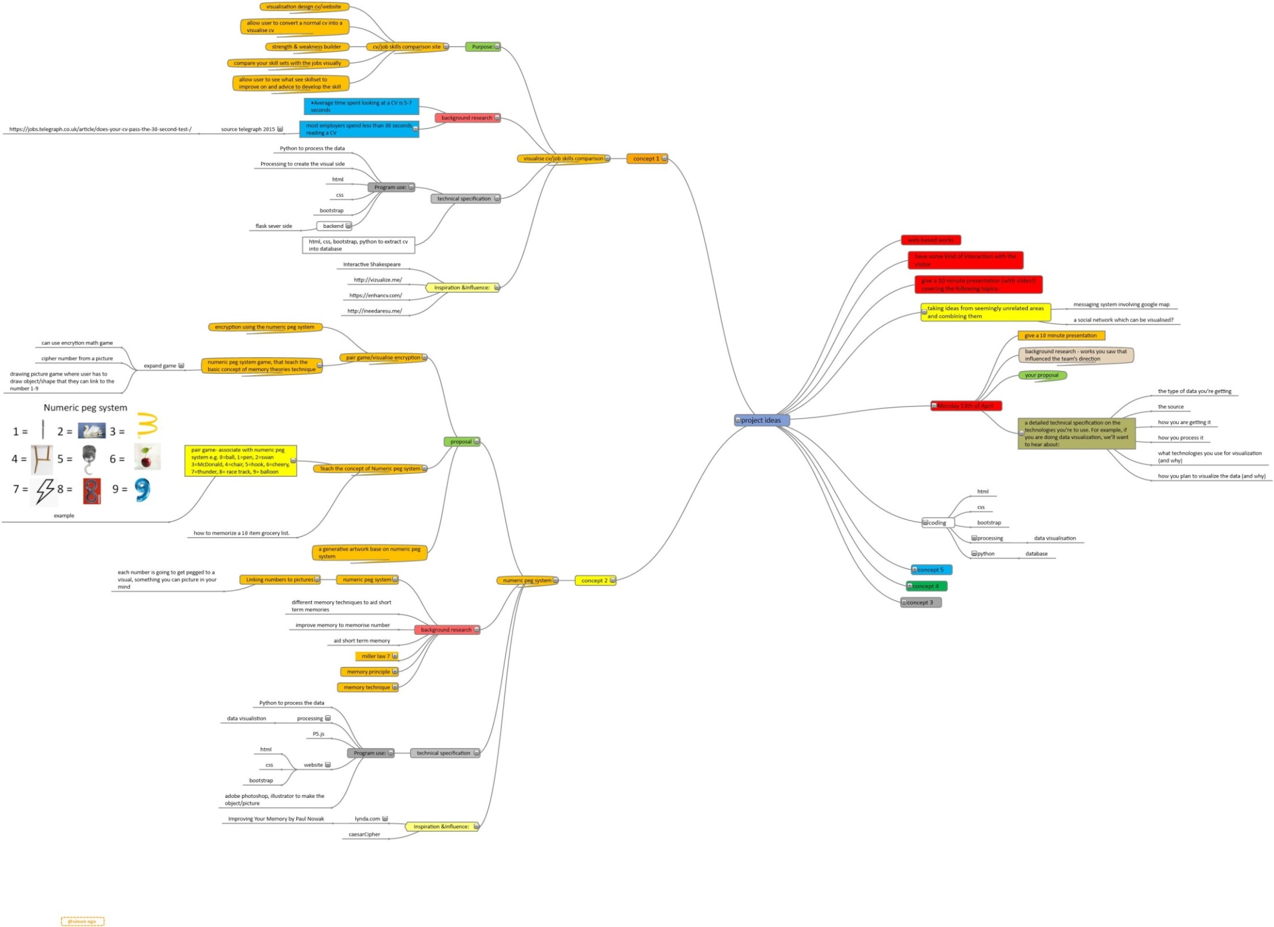

Slide 27
